Slide 1

Law, Ethics and Governance for All Leaders, including an Overview of New and Emerging Issues
AJG/LEGAL ONE: Monday Madness - Parents and Community as Partners: A Pathway for Reducing Legal Exposure
August 10, 2026

Slide 2
Presenters
David Nash, Esq., Director of Legal Education of National Outreach
Rebecca Gold, LEGAL ONE Consultant

Slide 3
Credits
Each session offers 2 QPA credits in Ethics. You must register, participate, and remain for the full session to receive credit. Certificates of completion, along with credits, are automatically issued once the online evaluation form is completed.
Participants are also eligible for 2 hours of continuing education credit which addresses the requirement for school leaders to complete training in school law, ethics and governance.

Slide 4
DISCLAIMER
This presentation is intended as a summary of law only and is not meant as legal advice. Please consult your attorney to obtain legal advice.
Participants are authorized to use the LEGAL ONE materials provided in this training to offer turnkey training within the respective participant's school district or place of employment, provided that participants provide proper credit to LEGAL ONE for having developed said materials and further provided that such turnkey training is offered at no charge.

Slide 5

Presentation Materials
Today’s document(s) can be accessed at
https://tinyurl.com/LO-AJG-260810
This folder can be accessed for 30 days from the session date.
Please download all files before the link expires.

Slide 6
Great Partnership
LEGAL ONE & New Jersey Schools Insurance Group
School Law Central
The LEGAL ONE Podcast
Monday Madness Series

Slide 7
Upcoming Monday Madness Session
All sessions 10 am – 12 noon via Zoom
NO COST TO REGISTER!
August 10 - Parents & Community as Partners: A Pathway for Reducing Legal Exposure
August 17 - The Role of Student Voice in Risk Management and Loss Control
August 24 - Building a Cohesive Staff Team and Ensuring a Healthy Workplace Environment

Slide 8
Key Topics
Why Work Together?
What Would You Do?
Common Areas of Dispute
Potential Legal Exposure
The LIGHT System - A Framework for Improving Outcomes
Rapid Fire Scenarios
Moving Forward

Slide 9
WHY WORK TOGETHER???

Slide 10
After All …
We are the experts on curriculum and instruction, student wellness, etc.
We have to follow the law
We are too busy to waste time on endless meetings
We can’t make “special rules” for every parent
We know what’s best for kids

Slide 11
What would you do???

Slide 12
Scenario 1 - What If …
On the first day of the school year, a parent sees the elementary school principal welcoming students at the entrance of the school and asks “Can I speak with you for a moment?” She then takes the principal by the arm and pulls him a few feet away for a “private” conversation.
The parent says that she heard some confusing rumors about schools not letting parents speak to the kids during the school day and wants you to clear up the confusion.
The principal responds, “yes, we have sent out several notices about this. I can’t believe you didn’t see any of them.”
The parent responds, raising her voice “Well excuse me. I have a lot going on right now.” The principal notices that many parents are now watching and listening in.
The parent continues, “Anyway, I know my rights. You will let my daughter have her phone and let me speak to her if I need to. I have a right to know my child is safe at all times and I also may need to contact my daughter if her ailing father takes a turn for the worse. She may only be 10, but she really is an emotional caregiver for her father.”
What legal issues are raised? What mistakes, if any, have been made? What do you do now?

Slide 13
Relevant Law
Internet-Enabled Device Law
  NJDOE Guidance
  NJDOE FAQ
Exceptions
  Caregiver
  Emergency Communications
Articles – School Law Central

Slide 14
School Law Central
April 2026 Issue (Issue 15) Focus on the new Internet-Enabled Device Law
  Article 1 – Navigating the New “Bell to Bell” Ban
  Article 2 – How to Address and Provide Disability and Health Related Exceptions
  Article 3 – Planning for Emergency Communications

Slide 15
Common areas of dispute

Slide 16
Where Problems Often Arise
Student Behavior
Chronic Absenteeism
Addressing Unique Student Needs
Student/Family Health and Wellness
Athletics
Use of District Facilities
Budget … My taxes pay your salary!
Others???

Slide 17
LEGAL REQUIREMENTS AND Potential legal exposure

Slide 18
Potential Legal Exposure
Large jury verdicts and settlements reached in recent cases involving child sexual abuse, bullying, suicide, discrimination
State and Federal Discrimination Law
NJ Child Sexual Abuse Victims Act
Breach of Duty of Care
Special Education Litigation on Rise

Slide 19
Student Behavior
Code of Student Conduct – Clear & Up to Date
  Include positive behaviors, not just negative – NJDOE Conduct Resources
HIB – Prevention, Identification, Response. Investigation, Due Process – NJDOE HIB Resources
NJ MOA Between Schools and Law Enforcement
Threat Assessment
  Credible Threat Report Requirement
  Exclusion for Dangerous –Students with disabilities
  NJDOE Threat Assessment Team Guidance
Substance Use
  Immediate Medical Exam
  Intervention/Referral
  NJDOE Resources on Substance Use Prevention and Intervention

Slide 20
HIB and Parent Communication
Required Notice when HIB investigation initiated, when the board of education is informed about the outcome of the ABS investigation
Problem – May be long period of time between start of investigation and meeting where BOE is informed. If no information given during that time, mistrust builds
Potential Solution – More communication. Permissible to provide additional verbal and/or written notices along the way, so parent understands the process and where things stand

Slide 21
Chronic Absenteeism
See NJDOE May 7, 2025 Broadcast Email - Frequently Asked Questions Related to Chronic Absenteeism and Supporting Regular Attendance
Announces release of (FAQ) document, Chronic Absenteeism: Frequently Asked Questions and Compliance Guidance on the Conditions for Learning webpage.

Slide 22
Initial
Home Instruction Sample Form

Slide 23
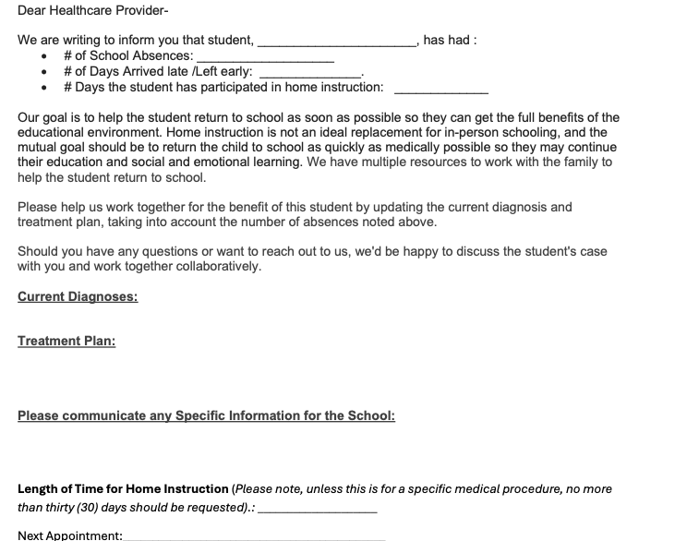

Slide 24
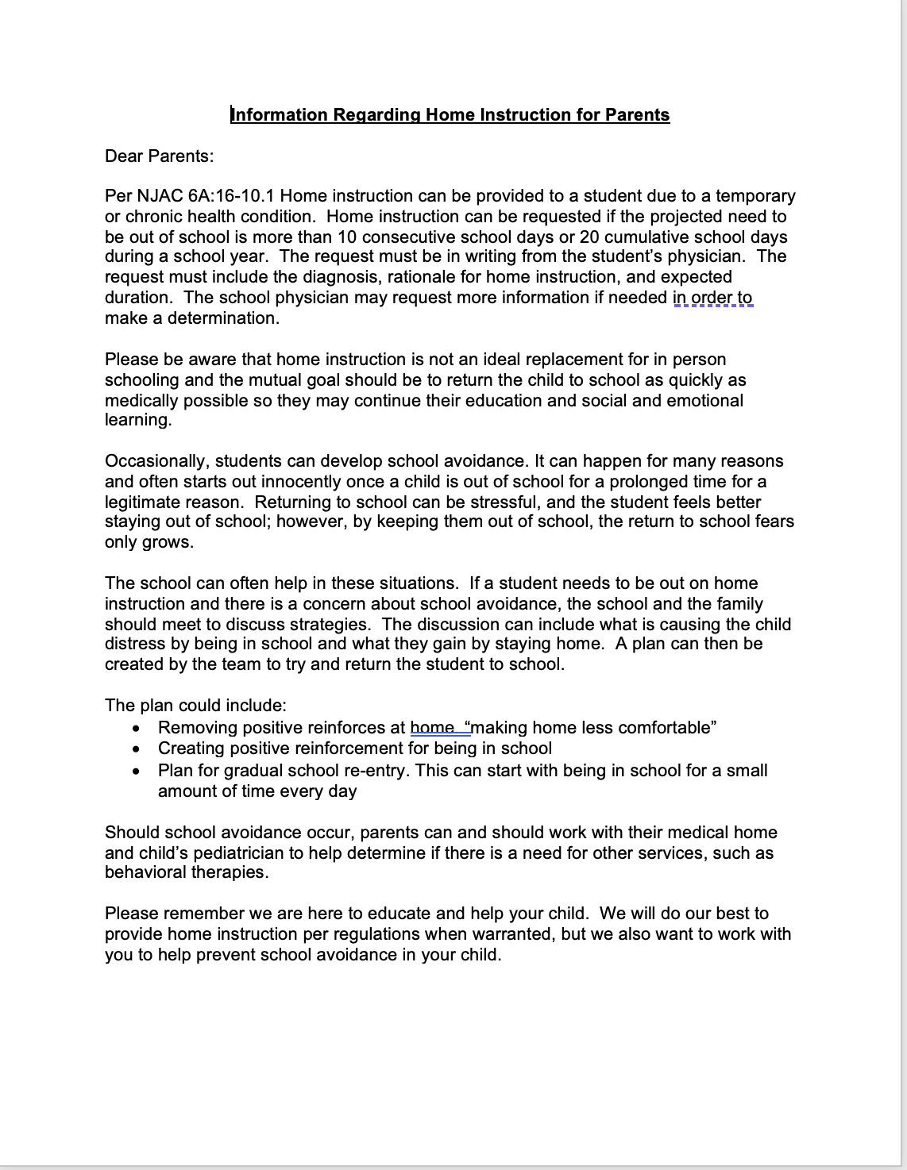
Sample Home Instruction Letter for parents

Slide 25
Improved Collaboration with Families
Trusted Resource
Have trusted school source get on phone with family
Negative Reinforcer
Find out about negative reinforcers:
What makes school difficult? Get teacher and parent opinions as well
Positive Reinforcers
Find out about positive reinforcers
What do they like about being home? Sleep in. Lots of screen time. No stress. No social pressure. Extra attention
Make Home Less Comfortable
Remove positive reinforcers
Usually screens, internet access
Re-entry
Make a plan for gradual Re-entry
Success
Create positive Reinforcers at school

Slide 26
Addressing Unique Student Needs
Multilingual Learners – NJDOE ML Resources
Students with Disabilities
  See NJPSA Resource Multilingual Learners with Disabilities
Gifted Students
  See NJDOE Resource on Identification of Gifted MLs
Athletics and Extracurricular Activities
  See NJDOE Information for Student Athletes
Gender, Gender Identity and Sexual Orientation
  See NJDOE Guidance
Religion Expression by Students – USDE Guidance
Race/Ethnicity – Title VI Guidance

Slide 27
Section 504
See OCR Parent and Educator Resource Guide to Section 504
Need to work with families to provide reasonable accommodations for students
If student is able to be in school with supports other than a medical doctor, student is entitled to attend

Slide 28
Athletics
Right to participate
Sportsmanship
Playing Time
Spectator Behavior
What can and can’t “stay within the team”
- Beyond Hazing - Badge of Honor example

Slide 29
Defining Sportsmanship
NJSIAA Sportsmanship Statement
Officials will read the following statement before every NJSIAA event at all levels (No Paraphrasing):
The NJSIAA requires officials to enforce all rules regarding unsportsmanlike conduct by coaches and players. There will be no tolerance for any negative behavior, such as taunting, trash talking and verbal, written, or physical conduct related to race, gender, ethnicity, disability, sexual orientation, or religion. Such behavior will result in being ejected from this event. All participants must respect the game and respect their opponents.

Slide 30
New Jersey Anti-Bullying Case Law
Dickerson v. Wallkill Valley Regional Bd. of Ed.,
U.S. Dist. Ct. N.J., 6/1/2020
Allegations that BOE, principal and superintendent violated NJLAD, U.S. Civil Rights Act and N.J. Civil Rights Act. Defendants motion to dismiss denied.
HS basketball game at which it was alleged that spectators made monkey sounds, shouted the “n” word and “monkey” at student during the game. Student allegedly suffered psychological distress, PTSD, anxiety and depression.
Principal/superintendent’s failure to respond to fans and decision to eject student’s father may have been so unreasonable so that one could infer that principal/superintendent acted with deliberate indifference. BOE/adm allegedly not HIB compliant.
Notes:
Cheng v. Rodas
School Ethics Commission
Decided: Sept. 23, 2015
Issue – Whether board president has unilateral authority to issue a Rice notice to the B/A.
Facts –
After consulting with the board attorney, board president issued Rice notice to B/A.
Board attorney advised that such authority derived from Persi v Woska
Rule –
Board President may unilaterally issue Rice notice to superintendent of schools
Analysis –
No written authority exists granting board president unilateral authority to issue Rice notice to any other than chief school administrator.
[E]xtending this unilateral authority to a Board President to interfere with the employment of a BA or a custodian is the grant of unbridled power ripe for abuse, in violation of the School Ethics Act.⁴ Conducting one’s office in such a manner would lead to violations of the statute, N.J.S.A. 18A:24.1(c), (e) and (i), for acting beyond the scope of a Board member’s authority, taking private action with the potential to compromise the Board or interfering with the proper performance of the employee’s duties.
The Respondent also argues that the legal advice the Board received insulates him from blame for his conduct. It does not. Each Board member undergoes ethics training and each is responsible for his own ethical conduct. That responsibility cannot be delegated or avoided.
Conclusion –
Here, where the Respondent was found to have violated N.J.S.A. 18A:12-24.1(e) for exceeding his authority as a Board member, the Commission finds that the penalty of reprimand is appropriate.
Persi v. Woska – Commissioner determined that board president unilaterally, or majority of the board could issue Rice Notice to CSA.

Slide 31
New Jersey Anti-Bullying Case Law
Dickerson v. Wallkill Valley Regional Bd. of Ed.,
U.S. Dist. Ct. N.J., 6/1/2020
Third circuit has not ruled conclusively on issue of whether there is a clearly established 14th amendment right protecting a student from an administrator’s deliberate indifference to racial harassment by other students.
Argument that principal/superintendent knew of an incident of HIB and failed to take sufficient action to minimize or eliminate the HIB; principal/superintendent may be subject to disciplinary action. N.J.S.A. 18A:37-16
Principal/superintendent may have individual NJLAD liability. Was aware of racially motivated harassment, present while it was ongoing and he did nothing to put an end to it; was deliberately indifferent. Duty as superintendent to respond.
Notes:
Cheng v. Rodas
School Ethics Commission
Decided: Sept. 23, 2015
Issue – Whether board president has unilateral authority to issue a Rice notice to the B/A.
Facts –
After consulting with the board attorney, board president issued Rice notice to B/A.
Board attorney advised that such authority derived from Persi v Woska
Rule –
Board President may unilaterally issue Rice notice to superintendent of schools
Analysis –
No written authority exists granting board president unilateral authority to issue Rice notice to any other than chief school administrator.
[E]xtending this unilateral authority to a Board President to interfere with the employment of a BA or a custodian is the grant of unbridled power ripe for abuse, in violation of the School Ethics Act.⁴ Conducting one’s office in such a manner would lead to violations of the statute, N.J.S.A. 18A:24.1(c), (e) and (i), for acting beyond the scope of a Board member’s authority, taking private action with the potential to compromise the Board or interfering with the proper performance of the employee’s duties.
The Respondent also argues that the legal advice the Board received insulates him from blame for his conduct. It does not. Each Board member undergoes ethics training and each is responsible for his own ethical conduct. That responsibility cannot be delegated or avoided.
Conclusion –
Here, where the Respondent was found to have violated N.J.S.A. 18A:12-24.1(e) for exceeding his authority as a Board member, the Commission finds that the penalty of reprimand is appropriate.
Persi v. Woska – Commissioner determined that board president unilaterally, or majority of the board could issue Rice Notice to CSA.

Slide 32
What About Other Comments
What if taunting, trash talking and verbal, written, or physical conduct occurs that is not related to a protected characteristic?
  E.g., Weight, appearance, intelligence, etc.

Slide 33
Group Discussion
  What does good and bad sportsmanship look like for your particular audience?
  How do we promote it?
  How do we enforce expectations? What is the role of the AD, coach, school administration, school security, athletes, others?
  What legal issues may arise related to Sportsmanship?

Slide 34
Use of District Facilities
Public v Non-Public Spaces
  See New Jersey Attorney General Model Policy for Schools on Response to Immigration Enforcement
Outside Group Use
Emergency Response Plans
NJ Attorney General Model Policy on Response to Immigration Enforement

Slide 35
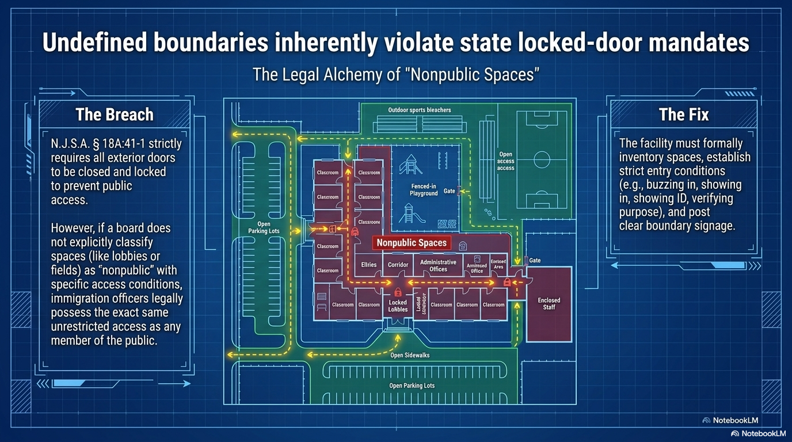

Slide 36
Budget
NJDOE User-Friendly Budget Requirement
Transparency
Community Input in Budget Development
Communication
Budget Referendums
  “Kid-lock” Example

Slide 37
The light system – A FRAMEWORK FOR MOVING FORWARD

Slide 38
The LIGHT© System
L Listen – what is the real issue?
I Isolate the conversation location for confidentiality
G Give a plan to address and resolve the concerns
H Help them understand why this has to be handled in a certain way
T Thank them for understanding and touching base with a follow-up within a reasonable amount of time. Information should be shared and ongoing, as needed.

Slide 39
What would you do???

Slide 40
Scenario 2 - Parent Upset About Grade
Mr. Rigid, the Middle School Algebra teacher, is meeting with parents at a parent/teacher night. Ms. Jones, the mother of Henry, walks in. Mr. Rigid recalls that Henry received a B minus on the first test he gave this year and was visibly upset, knowing that the test counts for 25% of the total grade. Ms. Jones explains that Henry has always been a straight A student, and that he became “distracted” over the last couple of weeks since he is dating a girl for the first time. Ms. Jones says Henry has never been this way before and it’s been hard to “get through to him.” She asks if there is any way Henry can retake the test now that she has spoken with him and reminded him that academics is his priority, and that there is plenty of time for dating when he is older.
Mr. Rigid responds by saying, “I can’t give Henry special treatment. He has to learn responsibility and will have to live with his grade. There’s nothing I can do. Perhaps you should start checking in with him to make sure he does his homework. I noticed you haven’t been logging in to the parent portal.”
What could Mr. Rigid have done differently?

Slide 41
Rapid fire scenarios

Slide 42
Rapid Fire Scenarios
Scenario 3 Parent IEP Meeting - This is all we can do and that is that!
Scenario 4 Drug and alcohol and smoking accusations and searches – You need to get here immediately and get your child for a drug test or we are contacting DCPP and law enforcement.
Scenario 5 Creation of the school year calendar with days off and holidays - I’m sorry, I know you are PTA Presidet. But we can’t accommodate your vacation schedule. The calendar was already set by two of our administrators. The board approves it next week.

Slide 43
Rapid Fire Scenarios
Scenario 6 Using the school building and its facilities for outside groups – Sure, our Assistant Superintendent knows your group very well. Of course, you can use our facilities, even though you missed the application deadline. We will make an exception and skip all the paperwork!
Scenario 7 Parent and community input on hiring for school positions – There is no opening for you to be on the hiring committee for a new principal. I know the other elementary school allowed it, but our process is different.
Scenario 8 Parent and community input on curriculum content and library “selection” book rules - We only allow opt outs to the health curriculum and we rely on our experts to develop curriculum and decide what are appropriate library books. So we don’t have any way for you to be part of the process.
Scenario 9 Parent and community input on budget - I understand that you are an active community member and have a right to know about our budget, While we haven’t had a lot of public presentations, rest assured we have worked very hard on the budget. We can answer any of your questions tonight, but we really need or board of education to finalize the budget. We are up against deadlines.

Slide 44
Moving forward

Slide 45

Conclusion
Thank you for choosing professional development with LEGAL ONE!
Visit our website for more courses that can support your work at http://www.njpsa.org/legalonenj/
Participants are authorized to use the LEGAL ONE materials provided in this training to offer turnkey training within the respective participant's school district or place of employment, provided that participants provide proper credit to LEGAL ONE for having developed said materials and further provided that such turnkey training is offered at no charge.
If you have any questions about this presentation or suggestions for future seminars, please send an email to legalone@njpsa.org

Slide 46
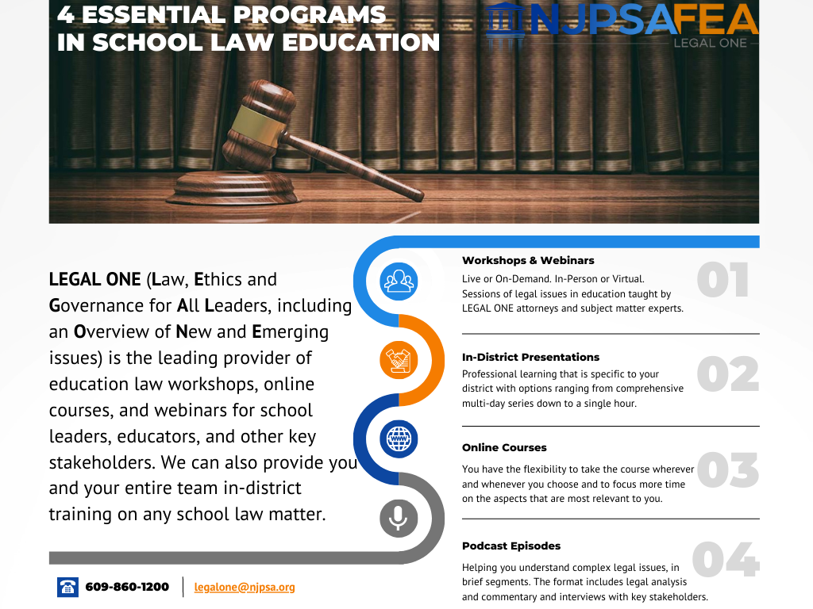

Slide 47

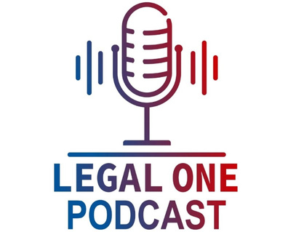

About the LEGAL ONE PODCAST
As the leading provider of school law training, the LEGAL ONE team of school law experts is pleased to offer the LEGAL ONE Podcast to help you understand complex legal issues through approximately 30-minute episodes
Available in Apple Podcasts and Spotify
LISTEN NOW

Slide 48

Advanced Certificates of Mastery
LEGAL ONE, the leading provider of school law training, provides programs with intensive small group instruction and one-on-one coaching with attorneys and subject matter experts that certifies that participants are able to demonstrate the real world, authentic knowledge and skills necessary to address critical roles.
Complete any of these programs to earn a digital badge.
Select Advanced Certificates of Mastery Available:
Anti-Bullying Professional (Fall ’26)
Affirmative Action Officer (Spring ’27)
Special Education Law (Spring ‘27)
For more information, contact legalone@njpsa.org

Slide 49

*LEGAL ONE:
Hot Issues in School Law
DATE
THURSDAY, AUGUST 27, 2026
WORKSHOP
TIME
9AM TO 3PM
What were the most important changes in state and federal law that occurred during the 2023-2024 school year? What must you do to address these changes moving forward? This seminar will address key topics, including: -Understanding the impact of shifting federal priorities on school districts legal obligations- Changes in state law regarding employee due process rights - Changing legal requirements related to diversity, equity and inclusion, student health and safety, and mental health- Understanding and addressing the needs of transgender students- Changing federal law requirements and guidance from the U.S. Department of Education; - The latest state and federal case law regarding HIB, IDEA, Section 504, tenure, discrimination law, First Amendment rights and more; - The latest guidance on educating and working with students with disabilities;- Legal considerations regarding the use of Artificial Intelligence in schools, and- Recent developments regarding employee, student and parent rights.
PRESENTER
SANDRA L. JACQUES, ESQ., LL.M., ASSISTANT DIR. OF LEGAL EDUCATION; JOHN WORTHINGTON, ESQ. COOR. OF SPEC. ED. LAW
FEE
$195 MEMBERS/NONMEMBERS
LOCATION
FEA CONFERENCE CENTER, 12 CENTRE DRIVE, MONROE TOWNSHIP, NJ 08831
CLICK TO REGISTER
NOTE: All professional development POs are to be issued to FEA and sent to feasupport@njpsa.org; "Member" pricing applies only to active NJPSA members.

Slide 50
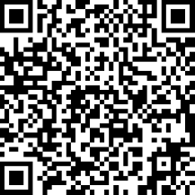
Certificate & Evaluation
Today’s professional development certificate is available to save/download at the end of a brief evaluation.
https://www.surveymonkey.com/r/LO-AJG-260810
Please take a few minutes to let us know what you thought of the session!

